Slide 1


Wiener filter without blurring

Slide 2

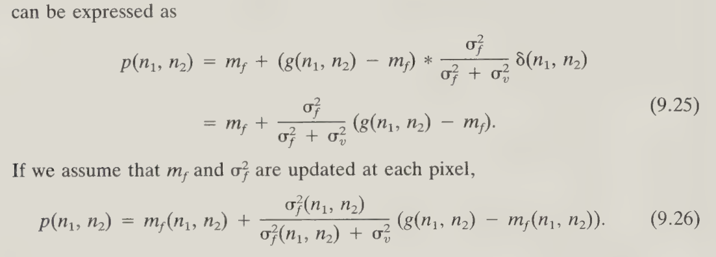
Adaptive Wiener filter without blurring

Slide 3


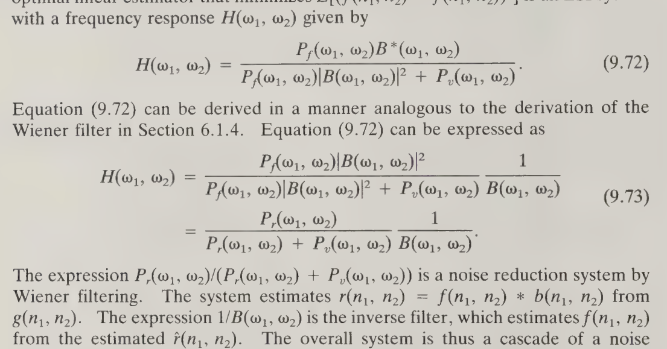

Slide 4


Slide 5

